Slide 1

CUSP 2016 Hack Day
2016 U.S. ELECTION OUTCOME
Team:
Maisha Lopa
Alexey Kalinin
Adrian Dahlin
Yue Cai
Chenxi Cui
Xianbo Gao
Jianghao Zhu

Slide 2
Content
Why do we care?
Our Approach
A Word on Data
Methodology
Analysis
Further Research

Slide 3
The outcome of the 2016 US presidential election was FAR off from the predictions.
Why did this happen? What did the analysts get wrong?

Slide 4
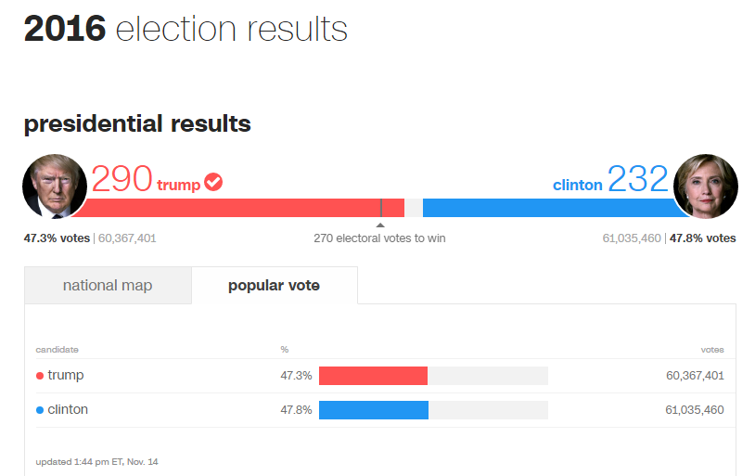
How influential were certain factors in explaining the Election outcome?
Education?
Racial Diversity?
Income?
Urbanization?
Foreign born?
http://www.cnn.com/election/results/president

Slide 5
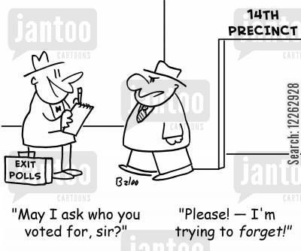
A Word on Data
Sources
Exit Poll Results for 37 U.S. States (NYT)
U.S. Census
ESRI
Data Limitations
Not all 50 states represented
New England States lacks results by county
(only township)
Not all votes calculated as of pull (11/13/2016)
Bias
Exit polls not an accurate representation of actual voting patterns

Slide 6
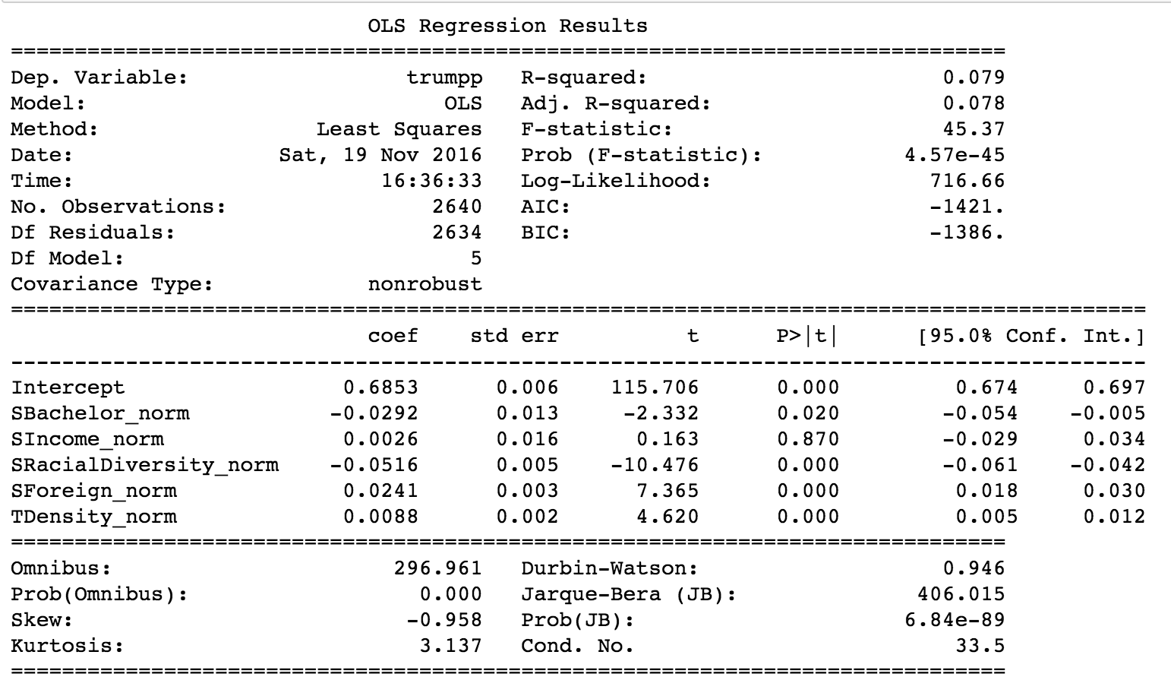
Methodology
Breakdown:
Data Wrangling
Merged exit poll data with census data
Regression Analysis
Regressed five explanatory variables against % votes for Trump
Visualization
Maps of the exit poll results across the U.S.
IMAGE

Slide 7
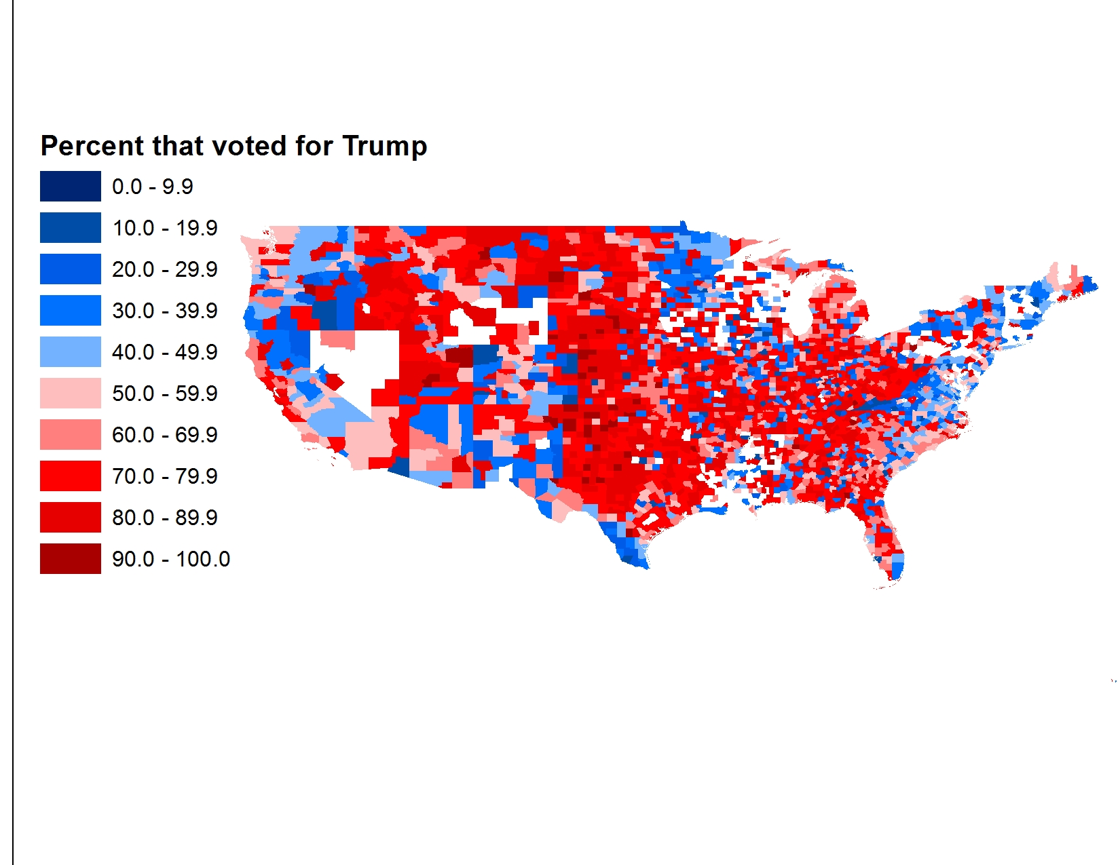
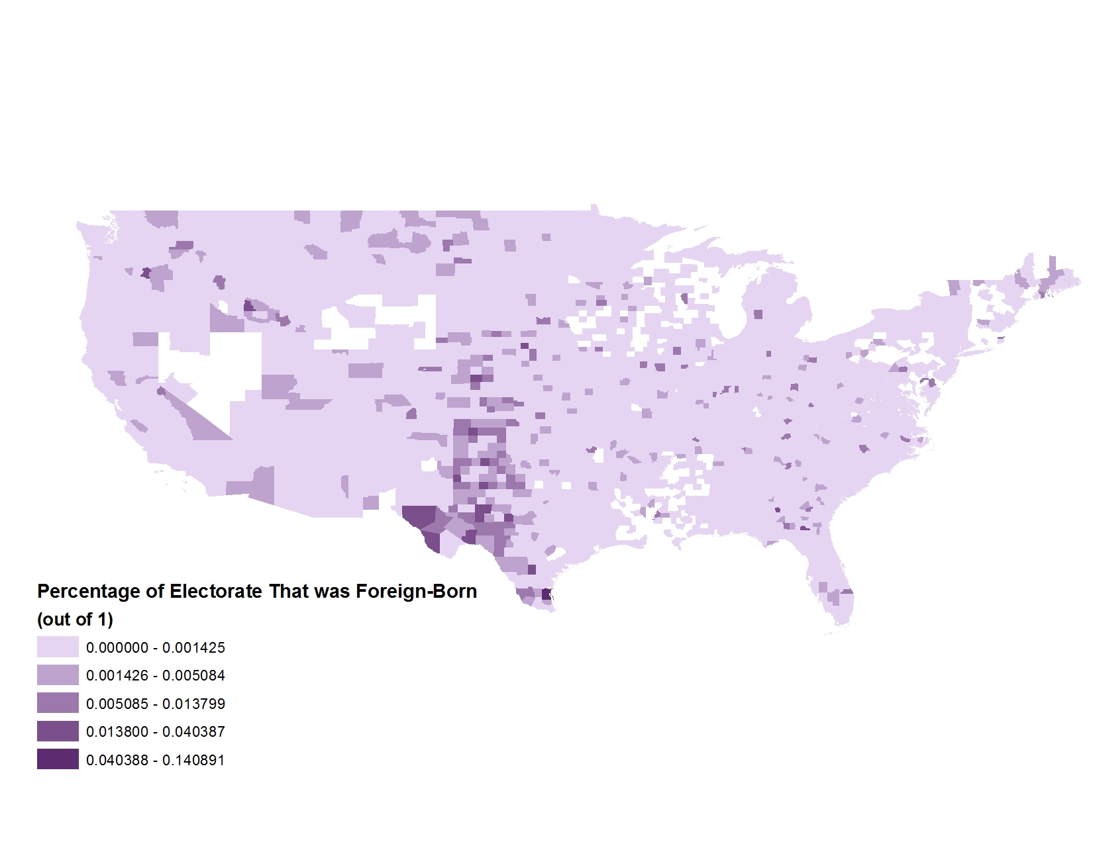
ANALYSIS: Compare Election Results with Foreign-Born Voters

Slide 8
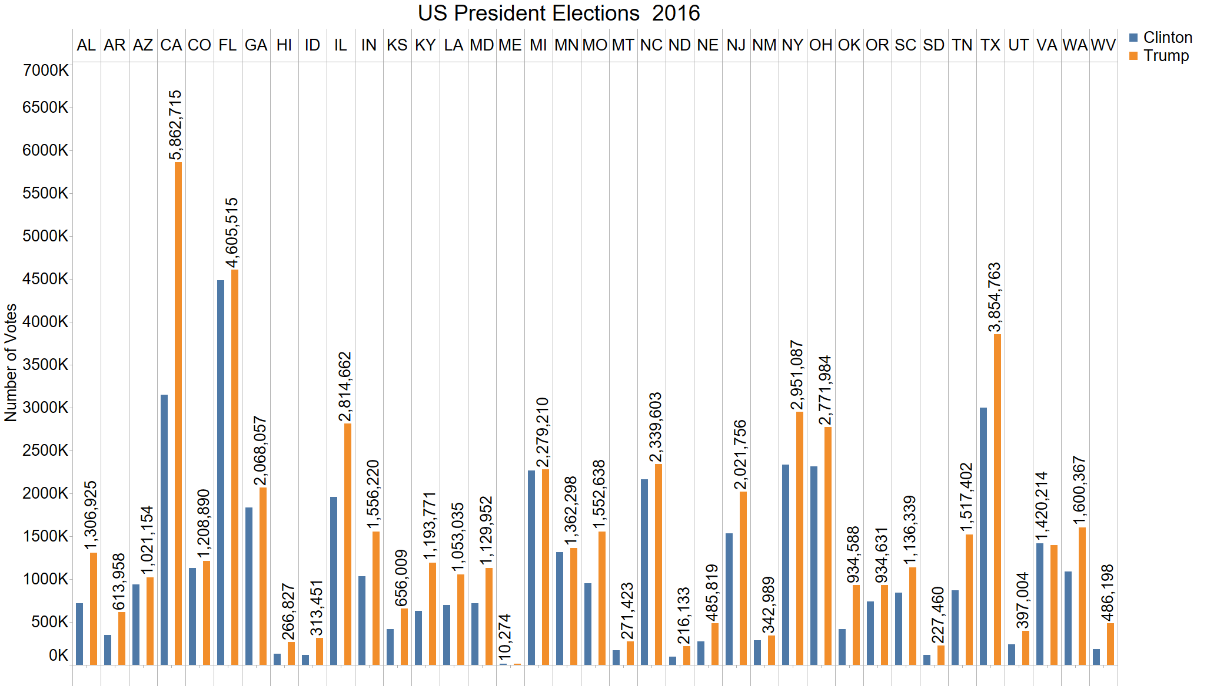
ANALYSIS: Elections Result 2016, counted by States
Note: calculated votes
Trump 54,763,093
Clinton 40,937,962

Slide 9
ANALYSIS: Which factors were influential?
Income and Density are significantly influential
Foreign, Bachelor, and Racial Diversity have influencing power

Slide 10
Further Research Needed
Run analysis for data from all 50 states
Conduct Random Forest analysis on the variables chosen

